Slide 1
Data Integration
Pravin Y Pawar
Adapted from Streamset's Data Integration guide

Slide 2
Data integration
Meaning
Data integration combines various types and formats of data from any source across an organization
into a data lake or data warehouse
to provide a unified fact base for analytics
Unified datasets allows businesses to
make better decisions,
aligns departments to work better together,
and drives better customer experience
Means consolidating data from multiple sources into a single dataset
to be used for consistent business intelligence or analytics
Very simple explanation for a complex topic that has evolved over its 30 year history
data integration has transitioned from a backend, retrospective process into core real-time infrastructure

Slide 3
Data integration(2)
Working
To move data from one system to another requires a data pipeline that
understands the structure and meaning of the data
as well as defines the path it will take through the technical systems
A relatively simple and common type of data integration is data ingestion,
where data from one system is integrated on a regular basis into another system
More complex way
may also include cleansing, sorting, enrichment and other processes to make
the data ready for use at its final destination
Sometimes this happens before the data is stored and the process is called ETL (extract, transform, load)
Other times it makes more sense to store the data first, then prepare it for use known as ELT
(extract, load, transform)

Slide 4
Data Integration Evolution
In the early 1990s, when companies began adopting data warehouses to collect data from multiple systems to fuel analysis,
there were no smartphones or ecommerce
Salesforce and Software as a Service as a category did not yet exists
Amazon had not sold a single book, much less on-demand computing
Back then:
Data came from business applications and operational databases in a structured format that could be mapped to the
structure required for analysis
Data arrived and was processed in batches, creating snapshots of the business in time and stored in data warehouses or
data marts
Data was used for financial reporting, sales dashboards, supply chain analytics, and other essential functions of the enterprise
Data integration was primarily the responsibility of ETL developers,
who used hand coding or specialized software to create ETL mappings and jobs
developed specialized skills related to the source and target systems they integrated
Data integration was owned and governed by enterprise IT
with control of the hardware and software used to collect data, store it, and analyze it
focused on performance, security, and cost of the monolithic data management systems

Slide 5
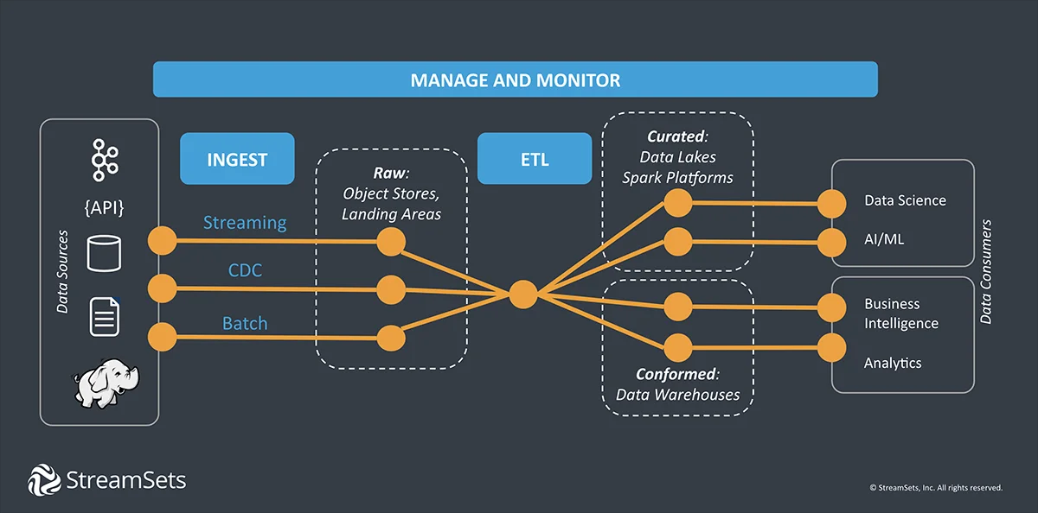
Modern Data Integration Space

Slide 6
Modern Data Integration Challenges
The world according to data looks very different today!
Enterprise data integration have been transformed by
explosion of data, data sources (IoT, APIs, cloud applications, on premise data, various databases, and more)
data structures combined with radical innovation in infrastructure services, compute power, analytic tools and
machine learning
Demand for (continuous) data
Real-time decision making and real-time services require continuous data that is transformed in flight
DevOps and agile software development practices have spread throughout the organization
increasing the demand for always on, self-service data
The move from on-premises to the cloud for applications as well as computing services requires cloud data
integration,
data integration beyond the walled garden of the corporate data center
Suddenly, the full lifecycle of data integration matters as much as the initial implementation
has to support continuous integration of data from different sources, and continuous data delivery as well as
continuous innovation,
and that takes automation
focus is not just on the “how” of implementation, but on “what” is needed by the business

Slide 7
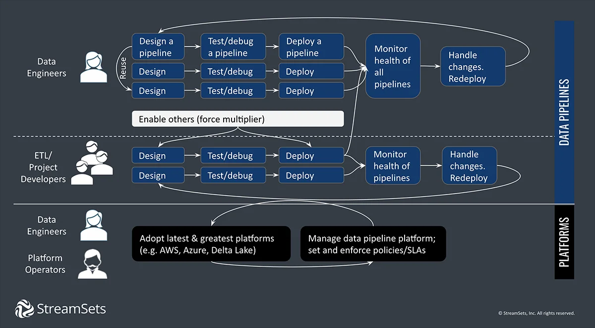
New Roles and New Responsibilities

Slide 8
Data Integration Tools
Data Integration tools are software-based tools that ingest, consolidate, transform, and move
data from source(s) to destination,
performing mappings, transformations, and data cleansing along the way
Ultimately, they integrate the data into a ‘single source of truth’ destination,
such as a data lake or data warehouse
allows consistent, reliable data for use in analytics and business intelligence

Slide 9
Data Integration Tool Considerations for the Age of Data Engineering
When choosing a tool for data integration, there are a few important considerations to take into account:
What type of data will be in your data pipeline?
Structured,
Unstructured
and Semi-structured Data
How will that data be processed?
Batch,
Micro-batch,
and Stream Processing
Where will the data come from and go to?
On-premises,
Cloud,
Multi-cloud,
and Hybrid Architectures

Slide 10
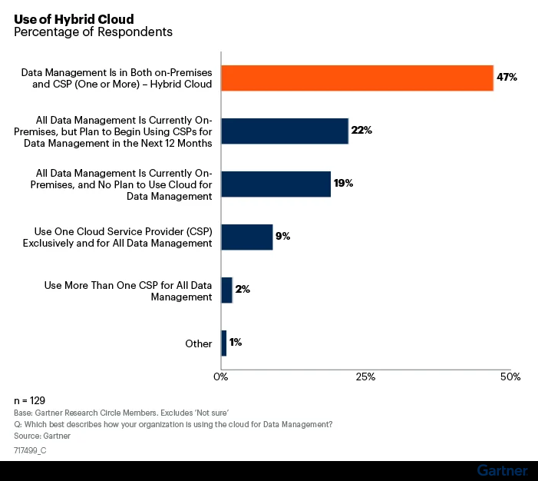
Moving to Hybrid Cloud

Slide 11
Thank You!
In our next session:

